Slide 1
Solving Interpretable
Kernel Dimension Reduction
Chieh Wu, Jared Miller, Mario Sznaier, and Jennifer Dy
Electrical and Computer Engineering Dep
Northeastern University
Video Presentation For NeurIPS 2019
Source code : https://github.com/chieh-neu/ISM_supervised_DR

Slide 2
Dimension Reduction
A lot of Features
Fewer Features used to represent the same data
Advantage of Dimension Reduction
Smaller size
Easier to handle
Faster to process
Smaller memory storage
Remove unimportant info
The Key is to
Remove unimportant data
Keep important data
Dimension
Reduction
Samples

Slide 3
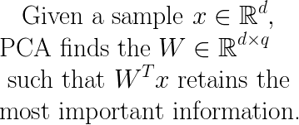
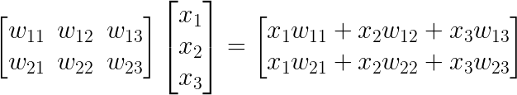
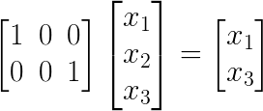
Principal Component Analysis (PCA)
PCA is by far the most popular Dimension Reduction technique, and it is interpretable !!!
We know exactly how the new features relate to the original features.
For example :
Here, we know exactly how the new features relate to the old features.

Slide 4
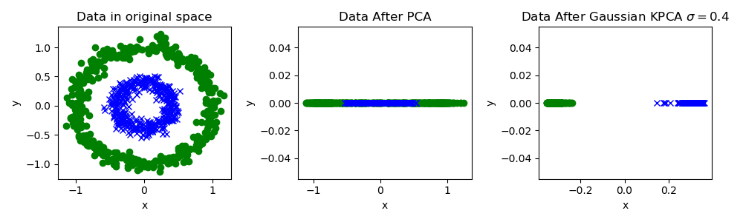
Principal Component Analysis (PCA)
But PCA only captures Linear Relationships!!!!
Ideally, after Dimension Reduction, samples of the same group should stay close together.
After Dimension Reduction, you can’t tell that Blue and Green are actually separated.
Note : This requires us to also capture
non-linear relationships!!!

Slide 5
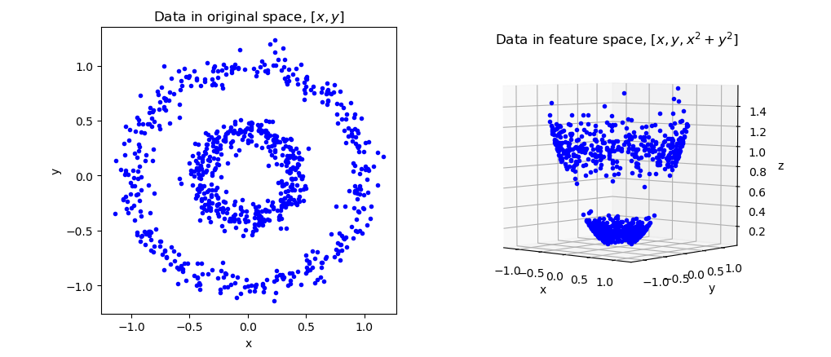
However, we know from the kernel community, if you first project the data into a higher dimensional feature space, non-linear relationships can become linearly separable.
Non-linear
Projection
PCA in
Feature Space
Data Space
Feature Space
PCA from Feature Space
This is called the Kernel PCA, or KPCA.

Slide 6
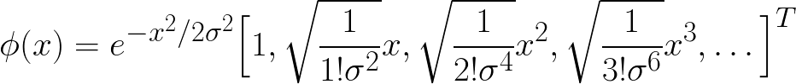
KPCA is very powerful, but …….
Problem 1: You cannot use labels to guide the dimension reduction
Problem 2: Since KPCA is PCA in the feature space, it's not obvious what they mean.
Here is the Gaussian Kernel feature map:
Not too obvious what running PCA on these features mean.
Interpretable Kernel Dimension Reduction solves both problems...

Slide 7
KPCA
Finds the W matrix in Feature Space
that keeps the most information.
Φ(X) W
Finds the W matrix in original data space that keeps the most information in the Feature Space.
Interpretable KDR
Φ(XW)
HSIC is a general objective for capturing non-linear dependence to achieve IKDR.
Although this make the solution interpretable, it is very difficult to solve.
HSIC(X,Y) measures the non-linear dependence between X and Y in
Feature Space.

Slide 8
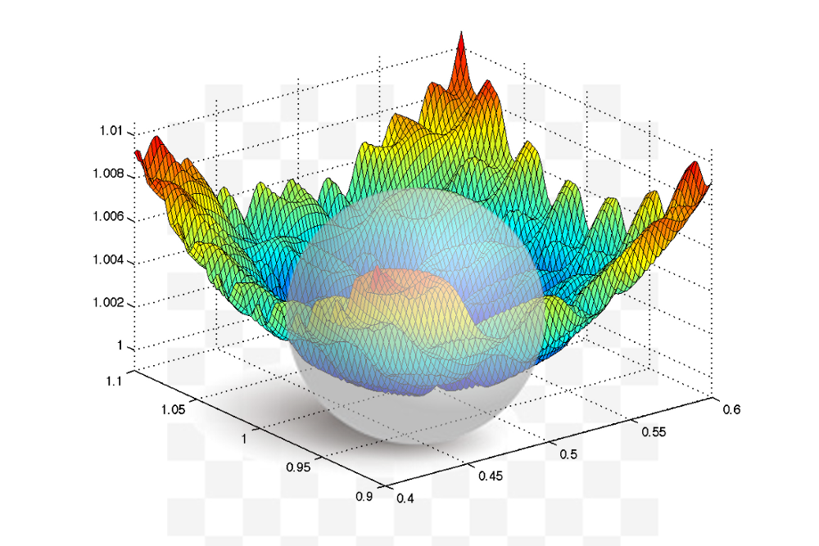

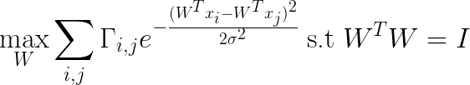
Unfortunately, IKDR is very difficult to solve !!
A generic IKDR problem :
Using a Gaussian Kernel :
This is a highly non-linear, non-convex shape where the solution must intersect with a hypersphere.

Slide 9
There are many existing ways to solve this !!!
Dimension Growth:
very slow
Difficult to implement
stuck at saddle point
poor results
Optimization Via Stiefel Manifold:
slow
stuck at saddle point
Difficult to implement
Decent results
Solve Via SGD :
Slow
stuck at saddle point
Easy to implement
Not good results
We propose the Iterative Spectral Method (ISM) :
very fast
doesn’t get stuck at saddle point (not gradient based)
Easy to implement
Very good results

Slide 10
We discovered a solution for the IKDR problem for a family of kernels.
The family of kernels is called the ISM Family.
We discovered that if a kernel is within the ISM Family, then the kernel has an associated Scaled Covariance Matrix Φ.
Just like PCA, the optimal solution W is the most dominant eigenvectors of Φ.

Slide 11
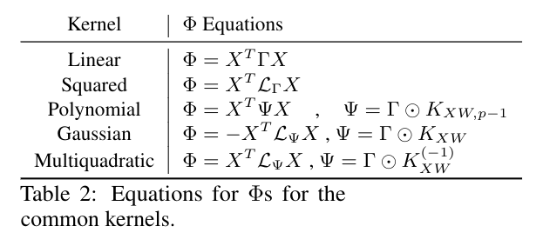
Here are some examples of kernels in the family and how the Scaled Covariance Matrix can be computed.
Sometimes the Scaled Covariance Matrix is a function of W itself. For these cases, we use the 2nd order Taylor Expansion
to approximate the Scaled Covariance Matrix.

Slide 12
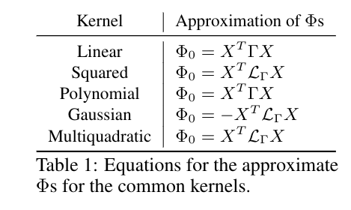
Here, notice that none of the Φ are functions of W.
Approximated Φ with Taylor Expansion.

Slide 13
By approximating Φ, we can initialize W and use this W to compute the next Φ. We can repeat this process until W converges.
This is the ISM algorithm.
We simply repeat this until W converges.

Slide 14

Although ISM look simple, the analysis required to guarantee its effectiveness was not simple !!!
Thm 1 :
Guarantees that the dominant eigenvector of Φ satisfies 1st and 2nd order conditions.
Thm 2 :
Guarantees that ISM algorithm converges to a subsequence.
Proposition 1 :
Any linear combination of ISM kernels is still a ISM kernel.
Thm 3 :
A ISM kernels can always obtain a Φₒ that’s independent of W
Corollary 1 :
The Φ matrix of a conic combination of kernels
is equal to

Slide 15
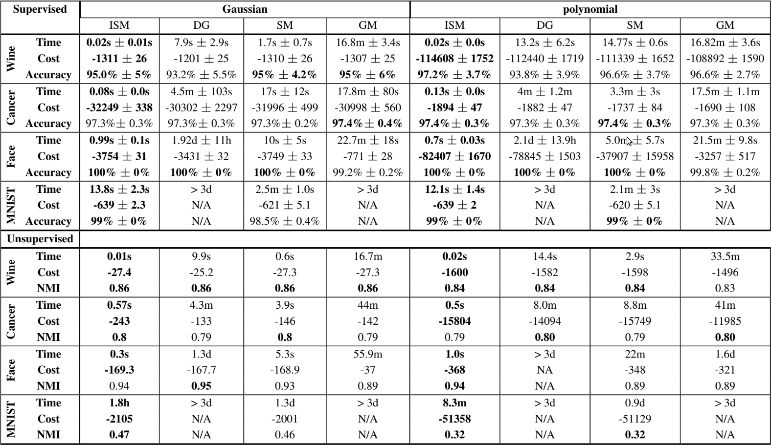
ISM solves many different IKDR problems.

Slide 16
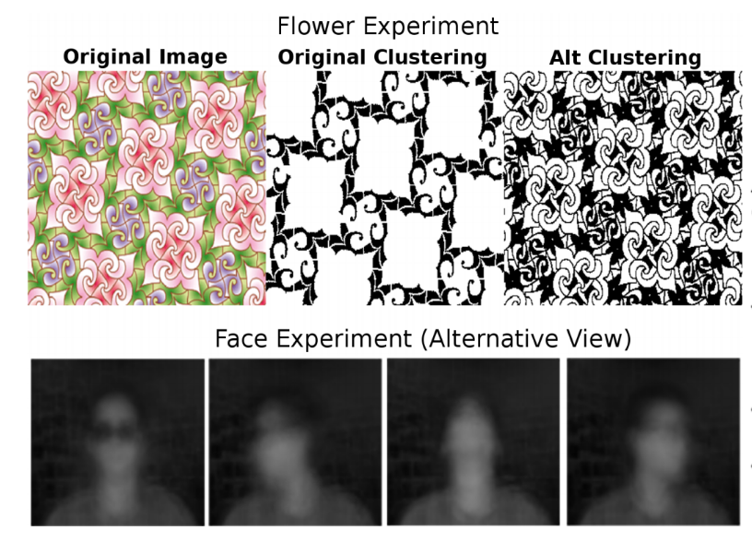
ISM can also be used for Alternative Clustering...

Slide 17

Come visit our poster at NIPS 2019 at :
Dec/8 - Dec/14
Poster : 4340
Vancouver Convention Centre , Vancouver Canada
Jennifer Dy
jdy@ece.neu.edu
Electrical & Computer Engineering Dept
Northeastern University
Chieh Wu
wu.chie@husky.neu.edu
Electrical & Computer Engineering Dept
Northeastern University

